Slide 1
Multiple Processor Scheduling
Multiple processor scheduling or multiprocessor scheduling focuses on designing the system's scheduling function, which consists of more than one processor.
Multiple CPUs share the load (load sharing) in multiprocessor scheduling so that various processes run simultaneously.
In general, multiprocessor scheduling is complex as compared to single processor scheduling.
In the multiprocessor scheduling, there are many processors, and they are identical, and we can run any process at any time.
The multiple CPUs in the system are in close communication, which shares a common bus, memory, and other peripheral devices.
So we can say that the system is tightly coupled.
These systems are used when we want to process a bulk amount of data, and these systems are mainly used in satellite, weather forecasting, etc.

Slide 2
There are cases when the processors are identical, i.e., homogenous, in terms of their functionality in multiple-processor scheduling.
We can use any processor available to run any process in the queue.
There may be special scheduling constraints, such as devices connected via a private bus to only one CPU.
There is no policy or rule which can be declared as the best scheduling solution to a system with a single processor.
Similarly, there is no best scheduling solution for a system with multiple processors as well.

Slide 3
Approaches to Multiple Processor Scheduling
There are two approaches to multiple processor scheduling in the operating system: Symmetric Multiprocessing and Asymmetric Multiprocessing.
Symmetric Multiprocessing: It is used where each processor is self-scheduling. All processes may be in a common ready queue, or each processor may have its private queue for ready processes. The scheduling proceeds further by having the scheduler for each processor examine the ready queue and select a process to execute.
Asymmetric Multiprocessing: It is used when all the scheduling decisions and I/O processing are handled by a single processor called the Master Server. The other processors execute only the user code. This is simple and reduces the need for data sharing, and this entire scenario is called Asymmetric Multiprocessing.

Slide 4
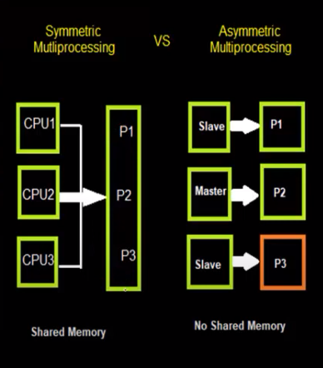

Slide 5
Processor Affinity
Processor Affinity means a process has an affinity for the processor on which it is currently running.
When a process runs on a specific processor, there are certain effects on the cache memory.
The data most recently accessed by the process populate the cache for the processor.
As a result, successive memory access by the process is often satisfied in the cache memory.
Now, suppose the process migrates to another processor.
In that case, the contents of the cache memory must be invalidated for the first processor, and the cache for the second processor must be repopulated.

Slide 6
Because of the high cost of invalidating and repopulating caches, most SMP(symmetric multiprocessing) systems try to avoid migrating processes from one processor to another and keep a process running on the same processor. This is known as processor affinity.
There are two types of processor affinity, such as:
Soft Affinity: When an operating system has a policy of keeping a process running on the same processor but not guaranteeing it will do so, this situation is called soft affinity.
Hard Affinity: Hard Affinity allows a process to specify a subset of processors on which it may run. Some Linux systems implement soft affinity and provide system calls like sched_setaffinity() that also support hard affinity.

Slide 7
Load Balancing
Load Balancing is the phenomenon that keeps the workload evenly distributed across all processors in an SMP system.
Load balancing is necessary only on systems where each processor has its own private queue of a process that is eligible to execute.
Load balancing is unnecessary because it immediately extracts a runnable process from the common run queue once a processor becomes idle.
On SMP (symmetric multiprocessing), it is important to keep the workload balanced among all processors to utilize the benefits of having more than one processor fully.
One or more processors will sit idle while other processors have high workloads along with lists of processors awaiting the CPU.

Slide 8
There are two general approaches to load balancing:
Push Migration:
In push migration, a task routinely checks the load on each processor.
If it finds an imbalance, it evenly distributes the load on each processor by moving the processes from overloaded to idle or less busy processors.
2.Pull Migration:
Pull Migration occurs when an idle processor pulls a waiting task from a busy processor for its execution.

Slide 9
Multi-core Processors
In multi-core processors, multiple processor cores are placed on the same physical chip.
Each core has a register set to maintain its architectural state and thus appears to the operating system as a separate physical processor.
SMP systems that use multi-core processors are faster and consume less power than systems in which each processor has its own physical chip.
However, multi-core processors may complicate the scheduling problems.

Slide 10
When the processor accesses memory, it spends a significant amount of time waiting for the data to become available. This situation is called a Memory stall.
It occurs for various reasons, such as cache miss, which is accessing the data that is not in the cache memory.
In such cases, the processor can spend upto 50% of its time waiting for data to become available from memory.
To solve this problem, recent hardware designs have implemented multithreaded processor cores in which two or more hardware threads are assigned to each core.
Therefore if one thread stalls while waiting for the memory, the core can switch to another thread. There are two ways to multithread a processor:

Slide 11
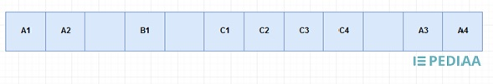

Coarse-Grained Multithreading:
In coarse grained multithreading, a thread issues instructions until thread issuing stops. The process is also called stalling.
When a stall occurs, the next thread starts issuing instructions. At this point, a cycle is lost due to this thread switching.
Consider the same example used in fine grained multithreading.

Slide 12
Thread A issues first and second instructions.
As it stops issuing instructions, the control passes to thread B, and there is one clock cycle loss.
Thread B executes the first instructions, and it stops.
Then the control passes to C, and there is one clock cycle loss.
Thread C issues four instructions before it stops issuing instructions.
Then the control passes back to A.
There is a clock cycle loss and thread A issues third and fourth instructions. And, this process continues.

Slide 13
2.Fine-Grained Multithreading:
In fine grained multithreading, the threads are executed in a round-robin fashion in consecutive cycles.
For example, assume a computer can issue one instruction per clock cycle. A, B, C are three threads.
The first 12 cycles of those threads are as follows.

Slide 14
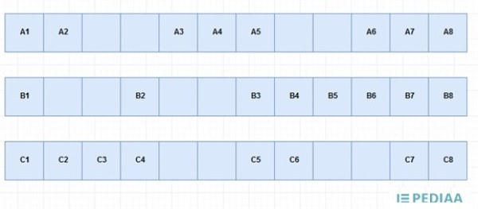

Figure 1: Example
The way of these threads issuing instructions according to fine grained multithreading is as follows.

Slide 15
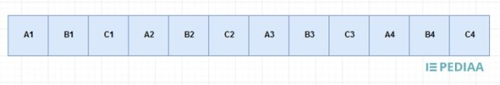
Each thread issues their first instruction.
Thread A issues its second instruction.
There should be 2 clock cycles between B1 and B2.
As 2 clock cycles have already passed, it is possible to issue second instruction of Thread B.
After that, thread C issues its second instruction. And, this process continues.

Slide 16
Real time scheduling
Systems that carry real-time tasks are known as real-time systems.
It is an operating system that is used for real time applications i.e. for those applications where data processing should be done in a fixed and small measure if time.
These tasks can be divided into two categories:
Soft real-time tasks: The task can be rescheduled.
Hard real-time tasks: The tasks need to be performed within a certain time period.
In this system, the scheduler is considered the most important component.
The scheduler aims to reduce the response time for each process.

